Slide 1
Sexual Morality and Ethical Relativism
Name
Institution
Date

Slide 2
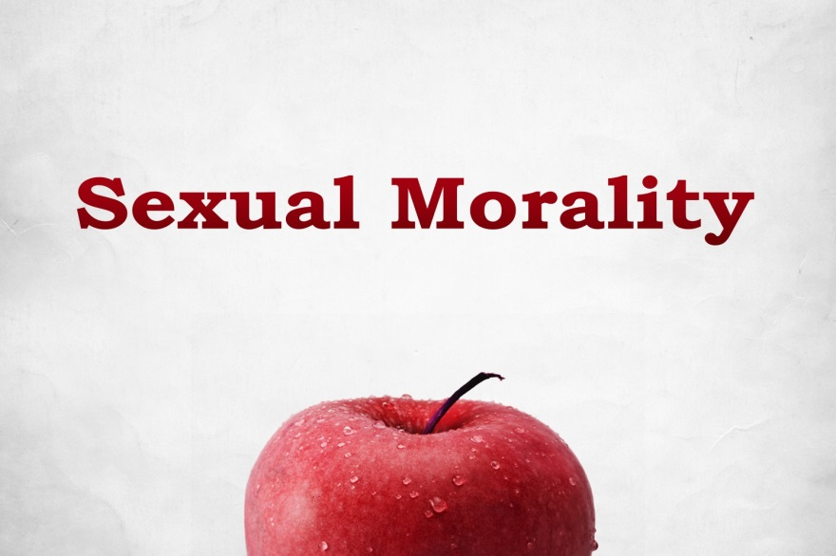
Introduction
Sexual morality considers ethics in morality
Human sexuality aspects raise issues in sexual ethics
Historically, religion and philosophy defined what was sexually ethical
Consent is a major consideration in sexual ethics (Cook et al., 2017)
Notes:
Sexual morality, also known as sexual ethics, is a philosophical branch that involves the consideration of ethics in sexual behavior. Sexual morality focuses on apprehending, assessing as well as critiquing interpersonal relationships from the perspectives of culture and society. Human sexuality aspects, including sexual orientation, consent, and gender identity, are perceived by many as the ones that raise ethical issues in sexual morality (Cook et al., 2017). Historically, religion and philosophy defined what was perceived to be sexually ethical. In modern society, consent to sex has been highly emphasized.

Slide 3
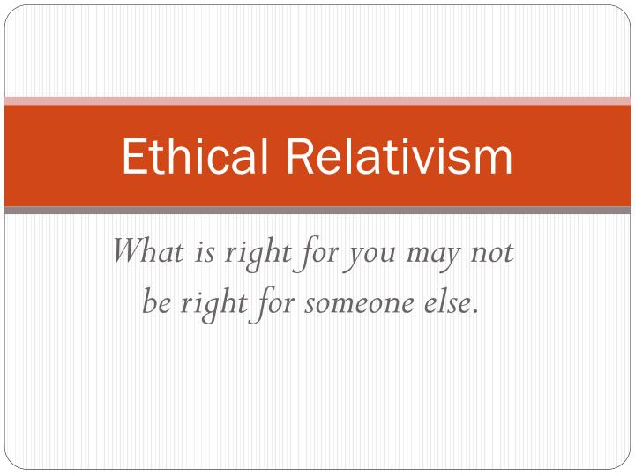
Ethical Relativism
States that morality is relative to the cultural norms of an individual
Society moral norms define what is right or wrong
Ethical relativists believe that there are no universal moral standards
Ethicists are mostly against this theory (Bajrami & Demiri, 2019)
Notes:
The theory of ethical relativism states that morality is relative to the cultural norms of an individual's culture (Bajrami & Demiri, 2019). This implies that societal moral norms define what is right or wrong. Similar actions may be morally wrong in one society but morally right in another society. For example, there are some states in the United States that have legalized abortion, while in others, abortion is illegal. Ethical relativists believe that there are no universal moral standards. Therefore, the only moral standards that can be used in judging a society are the moral standards of that society. However, the majority of ethicists are against this theory. Some argue that although societal moral practices may vary, essential moral principles governing such practices do not vary.

Slide 4

Ethical Dilemma
Abortion is a sexual morality issue that raises ethical concerns
It involves pregnancy termination through embryo removal or expulsion
Abortion denies the fetus its human rights
Abortion is considered a form of murder (CDC, 2020)
Notes:
The selected ethical dilemma is abortion. Abortion is one of the issues of sexual morality that raise ethical concerns. Abortion involves pregnancy termination through embryo removal or expulsion. Abortion can either be a miscarriage or induced. Miscarriage abortion is one that does not involve any intervention, while induced abortion is the one that follows certain steps in terminating the pregnancy. Abortion is considered an ethical issue because it involves terminating the life of the fetus. Scientifically, the fetus is a living being whose human rights, such as the right to life, should be respected. Abortion may also be perceived as a form of murder. In 2018, CDC reported a total of 619 591 legally induced abortions in the United States (CDC, 2020). However, those who support abortion argue that physicians should respect the rights of pregnant women.

Slide 5

Ethical Theory
Deontological ethics relate to the ethical dilemma of abortion
Deontologists state that rules set define whether an action is right or wrong
They support their arguments using Christianity
Notable, they note that God is the giver and taker of life (Lazar, 2017).
Notes:
One of the ethical theories related to the ethical dilemma of abortion is deontology. Deontology holds that an action's morality depends on rules set that define whether the action is right or wrong instead of relying on the impacts of the action (Lazar, 2017). Deontologists borrow from the teachings of Christianity. Notably, deontologists believe that life is God's gift and all human beings, including the fetus, have the right to enjoy this gift unconditionally. God is the absolute giver of life, and He also has the divine moral obligation to take away life. Therefore, deontologists argue that abortion is immoral because it violates this divine provision. Abortion involves the termination of the life of the fetus, and therefore it violates the provisions of the Christian denomination.

Slide 6

Recommendations
Proper education on reproductive and sexual health
Effective use of contraception
End sexual abuse
Provide alternatives to abortion (Packer, 2018)
Notes:
One of the most effective ways to end unintended pregnancies that result in abortion is the provision of regular education about sexual health. Sexual education involves equipping learners with adequate knowledge on how they can remain healthy and protect themselves from unwanted pregnancies and sexually transmitted infections (Packer, 2018). Contraceptives, such as condoms and birth control pills, should also be made available to prevent unwanted pregnancies. The government and communities should also provide opportunities aimed at empowering girls and women as one of the interventions to end sexual abuse. Women opting for abortion should also be educated on available alternatives such as giving up children for adoption.

Slide 7
References
Bajrami, D., & Demiri, B. (2019). Ethical relativism and morality. ILIRIA International Review, 9(1), 221-230.
CDC. (2020). Reproductive Health. Retrieved from https://www.cdc.gov/reproductivehealth/data_stats/abortion.htm
Cook, C., Schouten, V., Henrickson, M., & McDonald, S. (2017). Ethics, intimacy and sexuality in aged care. Journal of advanced nursing, 73(12), 3017-3027.
Lazar, S. (2017). Deontological decision theory and agent-centered options. Ethics, 127(3), 579-609.
Packer, C. (2018). Sex Education: Child’s Right, Parent’s Choice or State’s Obligation?. In Of innocence and autonomy (pp. 163-178). Routledge.

